Slide 1
Go Lang Programming
By Verrol Adams

Slide 2
Required Software Apps
Setting Go
Install Go tools from http://golang.org
Install Git
Software Version Control tool
http://git-scm.com
IDE/Editor
Microsoft Visual Studio Code with Go plugin
https://visualstudio.com/products/code-vs

Slide 3
GOPATH Directory Structure
go-lang-programming
src
github.com
work-repo
bin
pkg
GOPATH →
my-projects
bob
susan
hello
awesome
hello2
fearless
my-projects

Slide 4
Chapter 1 – Installation and Setup
Section 1
Go Tools Installation for Windows

Slide 5
Windows Installation
Download the ‘Required Software’ for your platform:
Install Git
Create a .gitconfig file in %HOME%\.gitconf:
> git config --global user.email “your@email.com”
> git config --global user.name “your name”
Install Go tools
Create GOPATH home directory
$ mkdir %HOME%\lcp
$ mkdir %HOME%\lcp\go-lang-programming
Set GOPATH env to point this directory
Install Visual Studio Code

Slide 6
Chapter 1 – Installation and Setup
Section 2
Go Tools and Plugin Setup for Mac OS X

Slide 7
Mac OS X Installation
Download the ‘Required Software’ for your platform:
Install Git
Create a .gitconfig file in $HOME/.gitconf:
$ git config --global user.email “your@email.com”
$ git config --global user.name “your name”
Install Go tools
Create GOPATH home directory
$ mkdir –p $HOME/lcp/go-lang-programming
Set GOPATH env to point this directory
Install Visual Studio Code
Install Go plugin

Slide 8
Chapter 1 – Installation and Setup
Section 3
Go Plugin Setup for Windows

Slide 9
Chapter 1 – Installation and Setup
Section 4
Go Tools and Plugin Setup for Linux

Slide 10
Linux Installation
Download the ‘Required Software’ for your platform:
Install Git
Create a .gitconfig file in $HOME/.gitconf:
$ git config --global user.email “your@email.com”
$ git config --global user.name “your name”
Install Go tools
Create GOPATH home directory
$ mkdir –p $HOME/lcp/go-lang-programming
Set GOPATH env to point this directory
Install Visual Studio Code
Install Go plugin

Slide 11
Chapter 2 – The Basics
Section 1
Getting To Know Go (golang)

Slide 12
Objectives
What is Go?
Why Learn Go?

Slide 13

Go (golang) Mascot

Slide 14
What is Go?
From http://golang.org:
Go is an open source programming language that makes it easy to build simple, reliable, and efficient software.
From Wikipedia ():
Go (often referred to as golang) is an open source programming language created at Google in 2007 by Robert Griesemer, Rob Pike, and Ken Thompson. It is a compiled, statically typed language in the tradition of Algol and C, with garbage collection, limited structural typing, memory safety features and CSP-style concurrent programming features added.
The language was announced in November 2009; it is used in some of Google's production systems, as well as by other firms. Two major implementations exist: Google's Go compiler, "gc", is developed as open source software and targets various platforms including Linux, OS X, Windows, various BSD and Unix versions, and since 2015 also mobile devices, including smartphones.

Slide 15
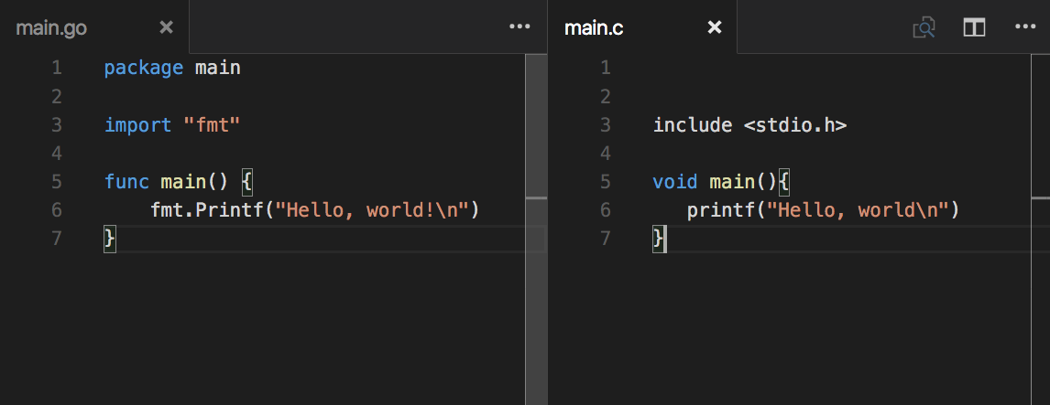
Go and C Compared

Slide 16
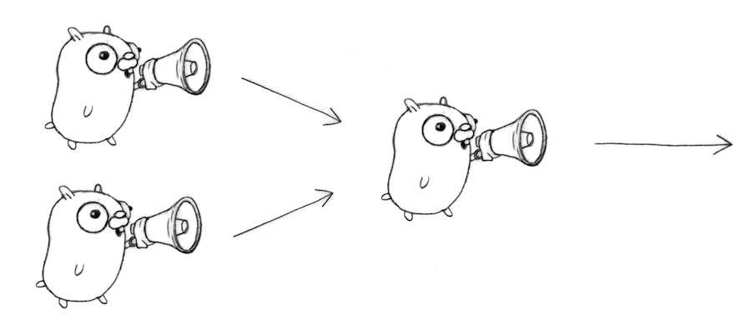
CSP: (Communicating Sequential Processes)

Slide 17
Why Learn Go?
Great talking point at your next geek party
One of the new coolest things to do
Job security
In existing job
In looking for new opportunities
Fun
A different way of thinking about software
Makes a lot of hard stuff, easier

Slide 18
Chapter 2 – The Basics
Section 2
Writing, Compiling, and Running Go Code

Slide 19
Objectives
General Structure of a Go Program
Package
Importance of the “main” package
imports
Program entry point
The “main” function
Using the ‘go’ tool chain
Compiling your program
Building an executable
Installing an executable
Running your programming

Slide 20
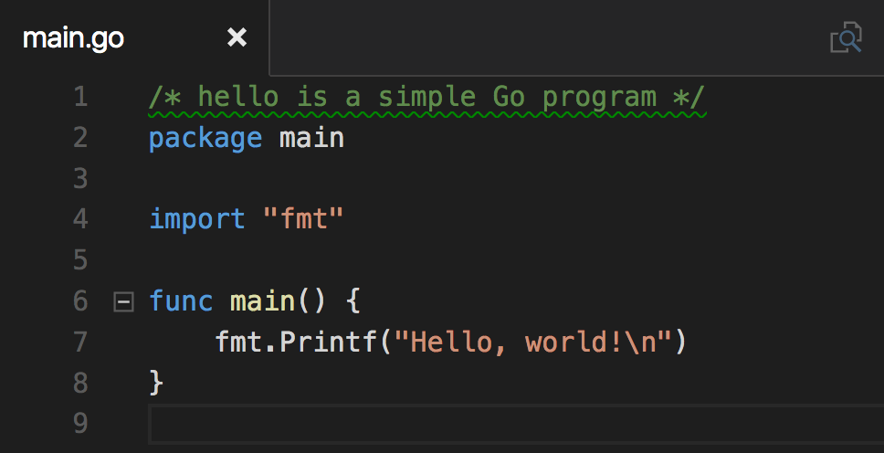
Minimalist Go Program

Slide 21
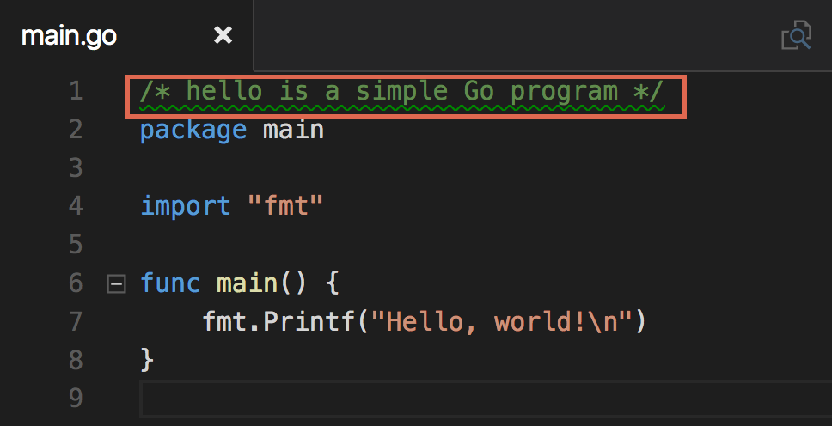
Comments

Slide 22
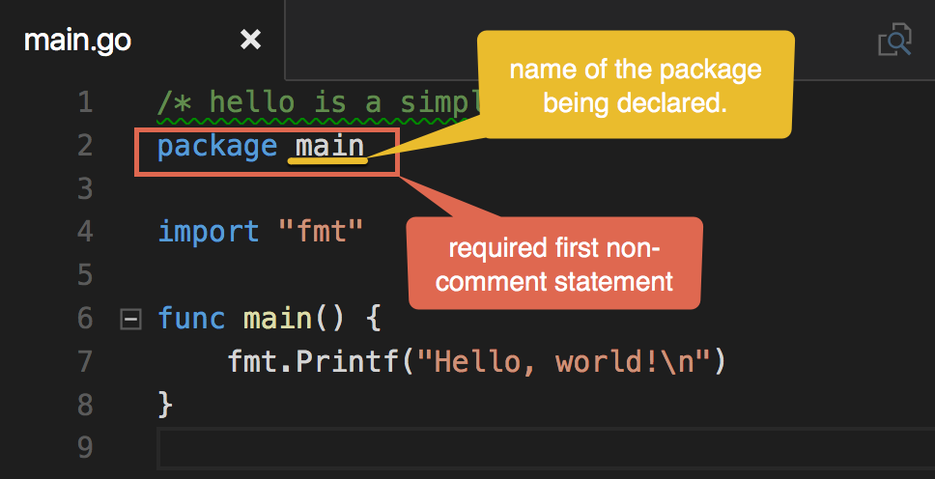
Package

Slide 23
Executable or Package
All Go source code belongs to either a package or an executable/application
A package provides reusable code in functions, types, methods, etc.
An executable/application is the only thing that can be invoked or be started by the operating system
An executable/application uses one or more package(s)

Slide 24
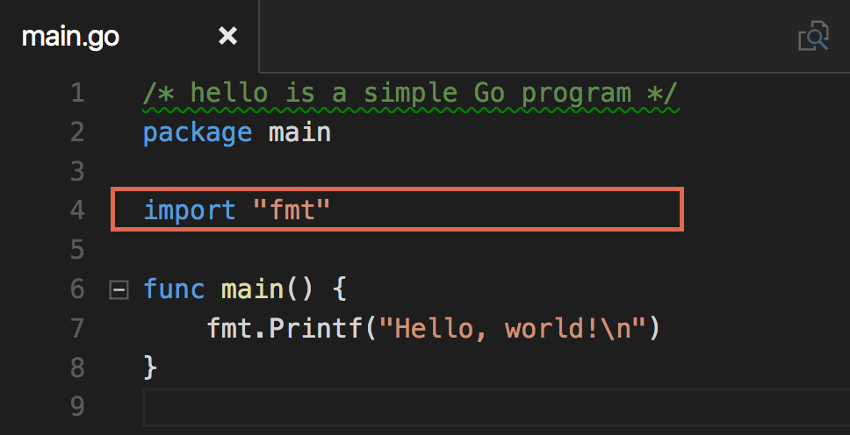
Import

Slide 25
An Hypothetical Program

Slide 26
Program Entry Point
First line
Agreed
function

Slide 27
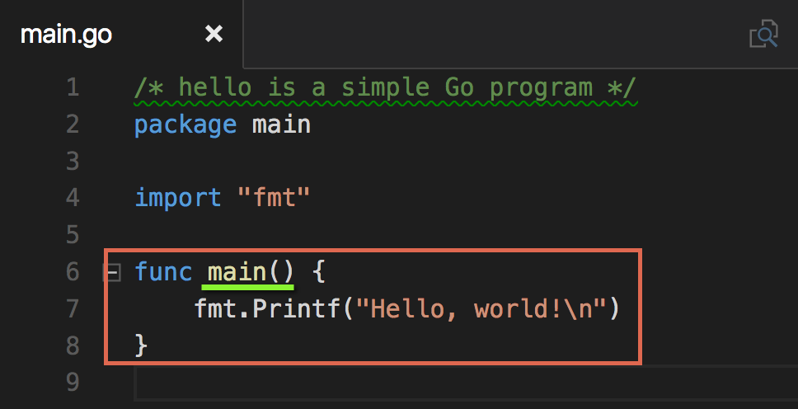
Main Function

Slide 28
Awesomely Complex Program
Package : task
Package : a
Package : main
Print()
Read()
main()
Write()

Slide 29
Using the “go” tool chain
Task | Command | Example
Run the source for an executable | ‘go run’ | ‘go run [file.go …]’
Compile source to an executable ‘main’ | ‘go build’ | ‘go build [file.go …]’
Install executable or package into $GOPATH/bin or $GOPATH/pkg | ‘go install’ | ‘go install’ or ‘go install <path>’
Format Go code | ‘gofmt’ | ‘gofmt <file.go>’
Manage imports | ‘goreturns’ | ‘goreturns <file.go>’
Get documentation | ‘go doc [package]’ or ‘godoc [package]’ | ‘go doc fmt’ and ‘godoc fmt’

Slide 30
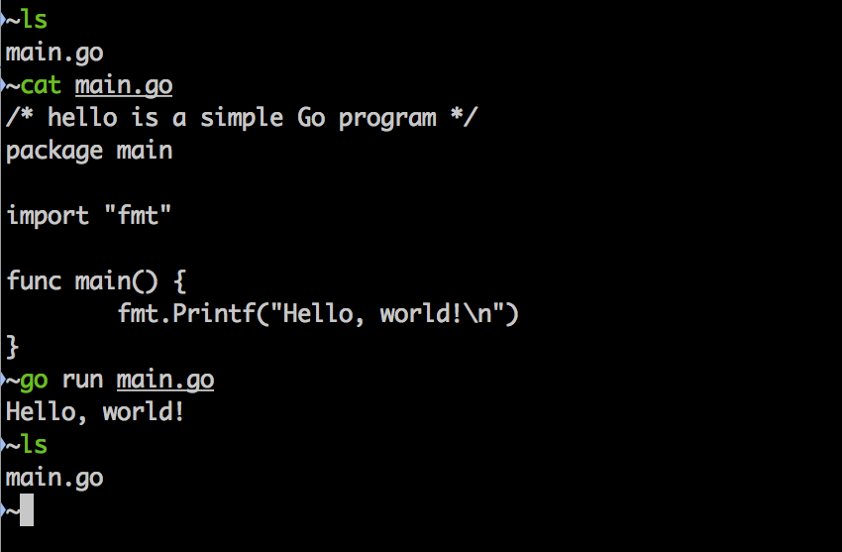
Compiling & Running

Slide 31
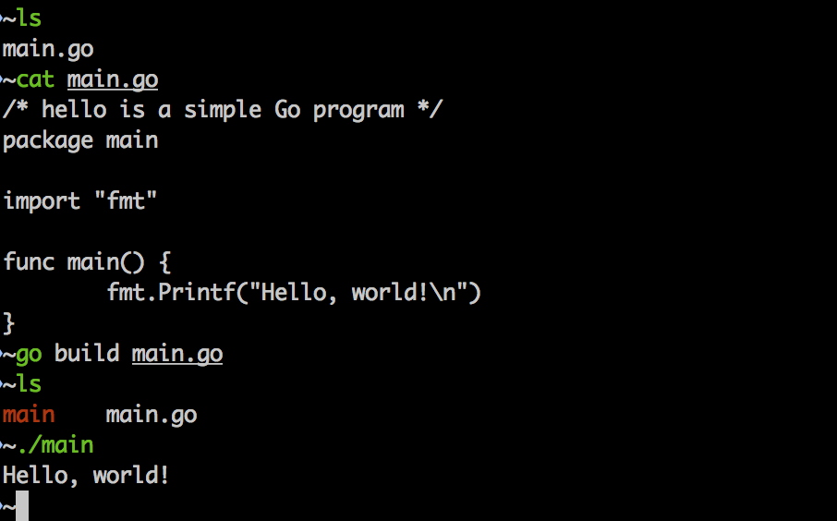
Building – Creating an Executable

Slide 32
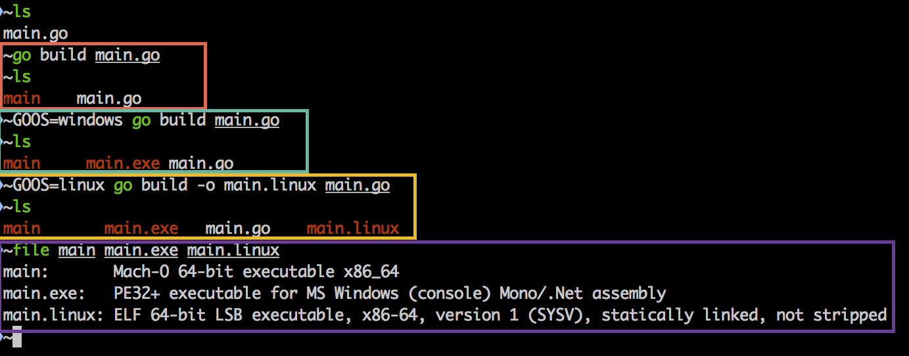
Cross Compiling/Building

Slide 33
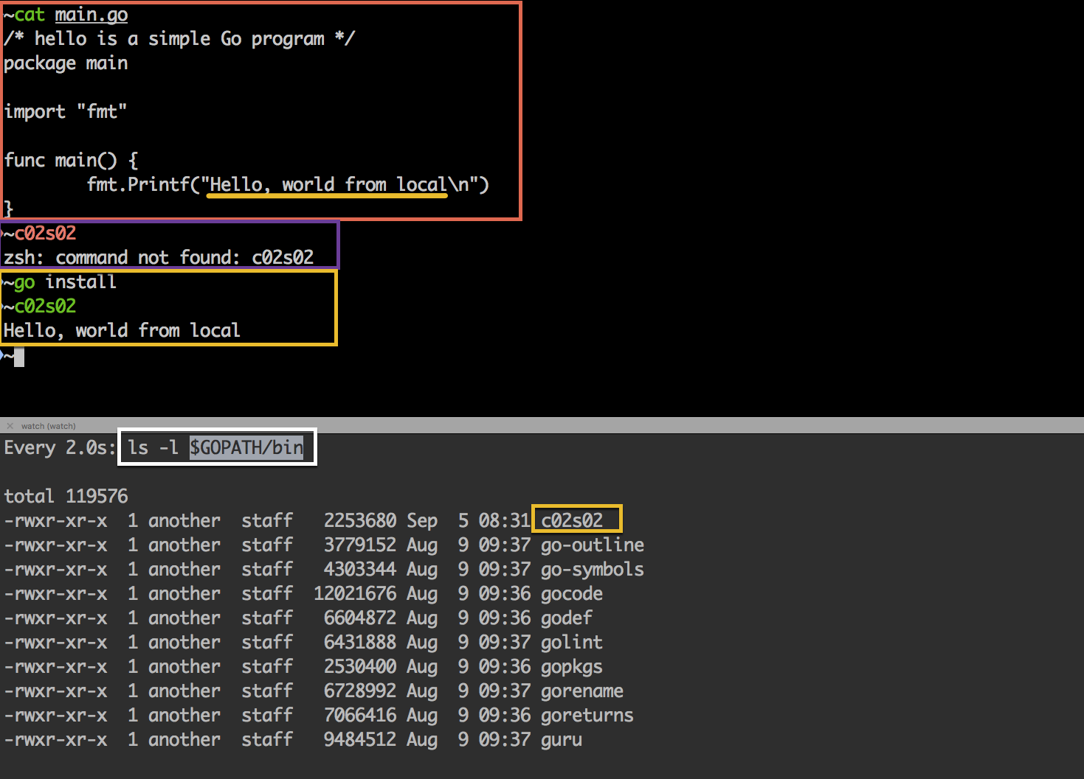
Installing Application (local)

Slide 34
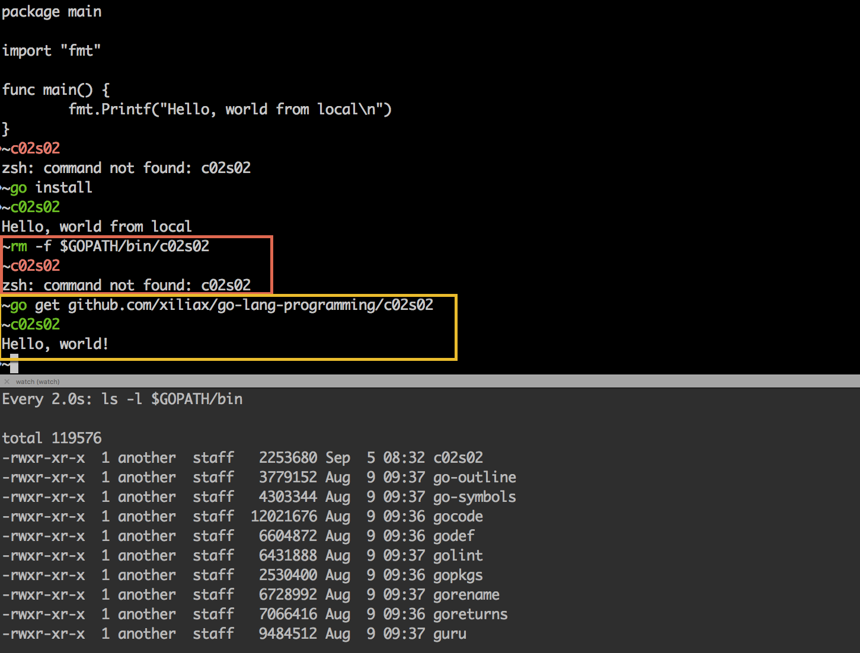
Installing Application (remote)

Slide 35
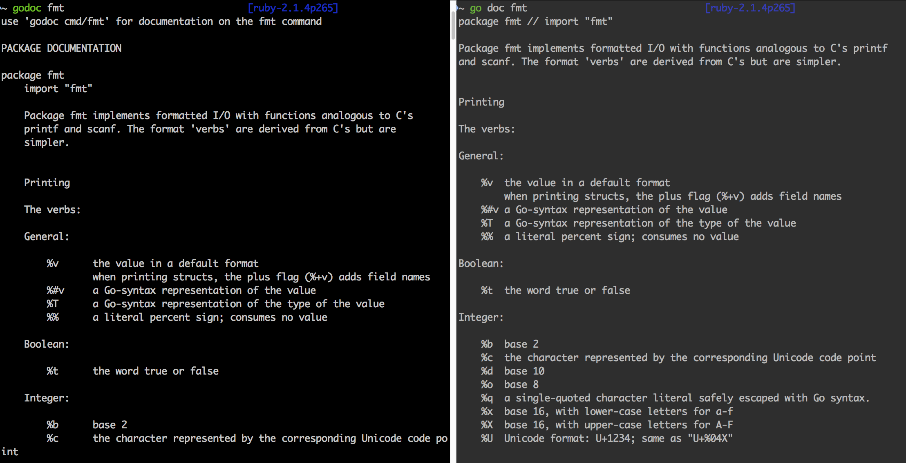
Package Documentation

Slide 36
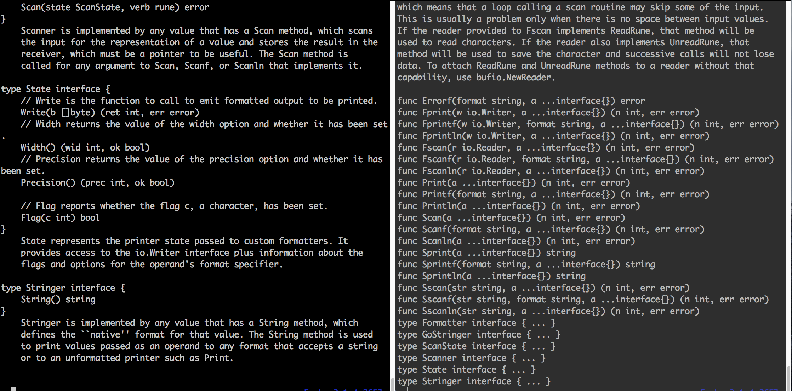
‘godoc’ vs ‘go doc’

Slide 37
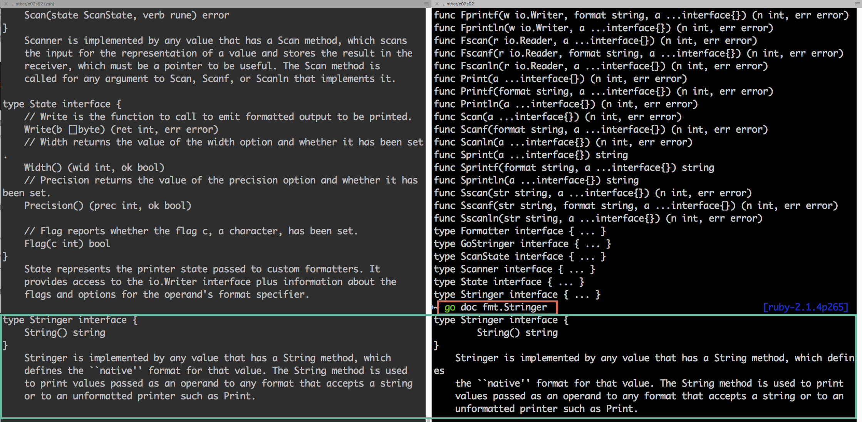
‘go doc fmt.Stringer’

Slide 38
Chapter 2 – The Basics
Section 3
Values, Bits, and Numbers

Slide 39
Objectives
Playing with Values
Bytes
Integers
Strings
Booleans
Arrays
Maps
Data Type and Storage (some)

Slide 40
Definition: Value
What is a ‘value’?
Verrol’s definition:
A value is an abstraction to represent a computed result
Not all values computed, some values just represents themselves. When a value stands for itself, we call it a literal. NOTE, a literal is still a value.
Examples:
6
6 is a value and also a literal, it stands for itself
3 + 1
will compute the value 4, but we don’t see for here
3.141592
“Verrol”
“Verrol” is a string literal, it is not a computed value, but still a value
true
true is also a literal in Go Language.

Slide 41
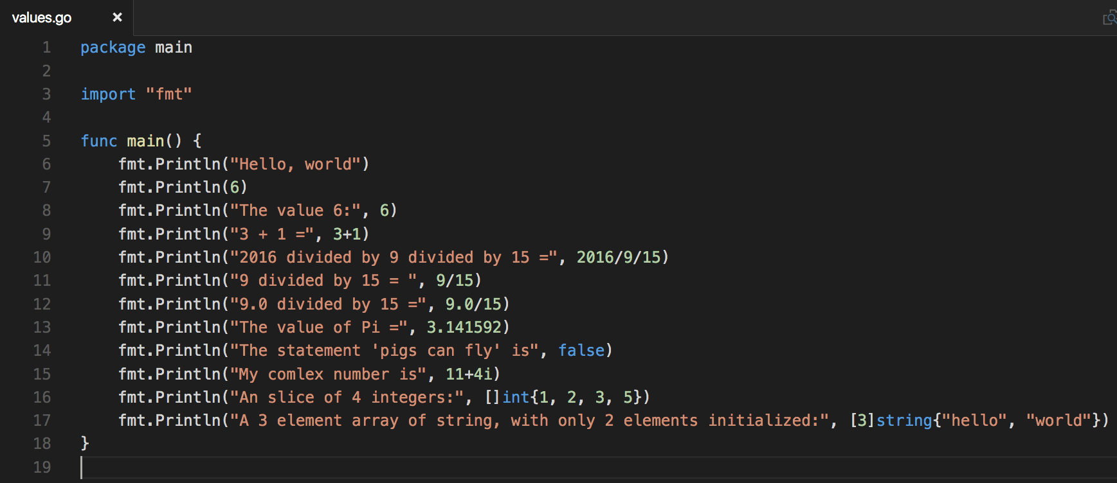
Playing with values

Slide 42
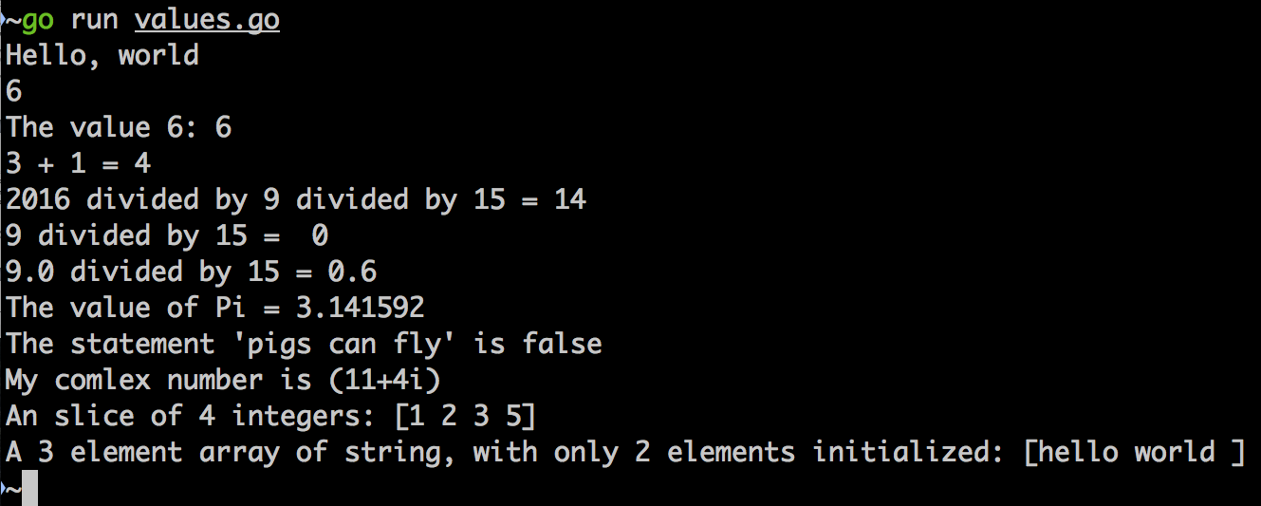
Demo

Slide 43
Everything is a Number
Everything typed into a computer is a character
Every character is represented by a number
A number is build up bit by bit, quite literally

Slide 44
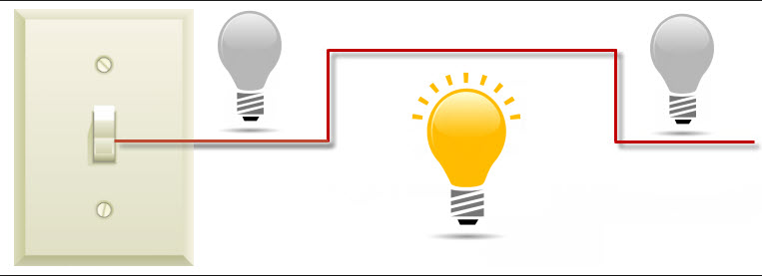
What is a ‘bit’?
Bit
A bit, is like a switch, it is either on or off
Each bit represents a binary value of 0 or 1
1
0
0

Slide 45


Counting with ‘bits’
Just as 1 bit can designate 2 distinct states or values, using multiple bits can designate even higher numbers of states/values.
A pair of light bulbs, can have 4 distinct states. Hence, 2 bits can designate 4 distinct states/values.

Slide 46
Bit Grouping Illustrated
Individual bits
…
Named grouping
…
Index:
bit’s location in group
0
1
6
7
MSB
LSB
Consider writing the decimal value for ‘one thousand two hundred and eight’:
Big Endian (left-to-right): 1 – 2 – 0 – 8
Little Endian (right-to-left): 8 – 0 – 2 – 1
NOTE: The most-significant-digit in big endian is on the left, while it is the right for little endian.

Slide 47
Grouping Bits
Grouping bits to represents numbers
4 bits = nibble
8 bits = byte
16 bits
32 bits
64 bits
most modern computers use this many bits for addressing
128 bits
Depends on programming language
and sometimes processor

Slide 48
Binary Number System
The ‘binary numbering system’ uses bits to represent numbers.
Since a certain number of bits allows us to represent a distinct number of states, we can choose to represent either positive or negative numbers.
To represent a negative number, we designate the MSB as the ‘sign bit’.
The ‘sign bit’ tells us if the number is positive or negative.

Slide 49
Signed and Unsigned Bits
Given a group of 4 bits, we can either:
Use all 4 bits as ‘unsigned bits’ to represent numbers:
Use 1 bits as the ‘sign bit’, s-bit, and the remaining bits to represent the value of the number:
x
x
x
x
Unsigned bits grouping
s
x
x
x
Signed bits grouping

Slide 50
Signed and Unsigned Bits: Illustrated
Unsigned Bits | Unsigned Value | Signed Bits | Signed Value
000 | 0 | 0-00 | 0
001 | 1 | 0-01 | 1
010 | 2 | 0-10 | 2
011 | 3 | 0-11 | 3
100 | 4 | 1-00 | 0
101 | 5 | 1-01 | -3
110 | 6 | 1-10 | -2
111 | 7 | 1-11 | -1
* Wikipedia: https://en.wikipedia.org/wiki/Signed_number_representations

Slide 51
Bit Grouping and Numeric Range
# of bits | # of unique values | Unsigned Number Range | Signed Number Range
8 | 2^8 = 256 | 0 to 255 | -127 to 127
16 | 2^16 = 65,535 | 0 to 65,534 | -32,767 to 32,767
32 | 2^32 = 4,294,967,295 | 0 to 4,294,967,294 | -2,147,483,647
64 | 2^64 = 18,446,744,073,709,551,615 | 0 to 18,446,744,073,709,551,614 | -9.22337203685478E18 to 9.22337203685478E18

Slide 52
Memory (simplified)
A mechanism or device for storing bytes
Memory capacity is measured in number of bytes
bytes
bits

Slide 53
Memory (addressing)
Question:
If my storage device can store X bytes, how do I access a particular byte?
Answer:
Addressing; each byte has it own address
bytes
0
1
2
3
4
…
# of bytes | Name
1024 | 1kilo-bytes (1Kb)
1024*1024 | 1mega-bytes (1Mb)

Slide 54
Storing Information Compared
Literature | Computer
Books | Programs
Chapters | Packages/Modules
Sections | Sub-packages/Sub-modules*
Paragraphs | Functions
Sentences | Statements
Words | Tokens
Characters | Characters
Letter, Number, Symbol | Letter, Number, Symbol
- | Bits
*https://golang.org/pkg/

Slide 55
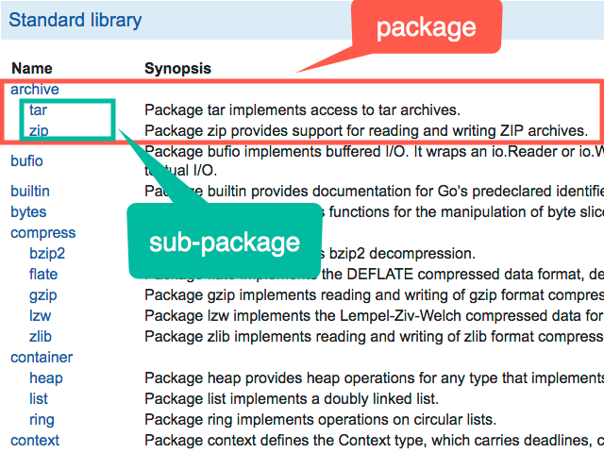

Slide 56
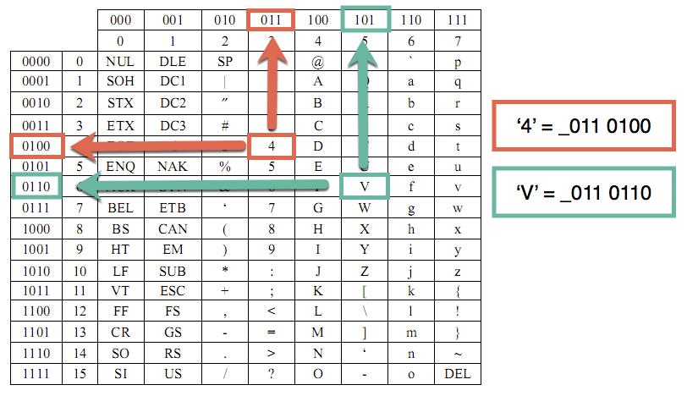
ASCII
A system for defining the letters, numbers , and symbols for groups of 8-bits (byte) values

Slide 57
Chapter 2 – The Basics
Section 4
Data and Data Types

Slide 58
Objectives
Understanding Data Types
Numbers
Byte
Rune
Integer
Float
Complex
Booleans
Strings
Data Type Storage (simplified)

Slide 59
ASCII
A system for defining the letters, numbers , and symbols for groups of 8-bits (byte) values
ASCII is only one of many encoding standards. Go Lang uses utf-8, which supports 8, 16, 24, and 32-bits encoding.

Slide 60
Values
Column 1
5
19
Verrol
true
false
3.14159
13.87
9/11/2001
Column 2
5e19
0.085
solid
orange
A
B
J
5 + 7i

Slide 61
Categorizing Values
Column 1
5
19
Verrol
true
false
3.14159
13.87
9/11/2001
Column 2
5e19
0.085
solid
orange
A
B
J
5 + 7i
5, 19, 5e19
3.14159, 13.87, 0.085
true, false
Verrol, solid, orange
A, B, j
9/11/2001
5 + 7i

Slide 62
Definition: Data & Data Type
What is ‘data’?
‘data’ is another name for ‘value’
The words ‘data’ and ‘value’ can be used interchangeably
What is ‘data type’?
Verrol’s definition:
A ‘data type’ is the formal specification of the interpretation and representation of a value
In other words, a value of a certain type must meet all the characteristics of the type
A type defines which operations are valid
Examples of types:
integer
float
boolean
String
Date
Complex

Slide 63
Example of Using Types
Type | OK | Error
uint8 | 8 + 16 | 8 + “16”
float64 | 3.1415 + 9 | 3.1415 + true
int32 | 1093890 | 243801 / “a10b5”
boolean | true || false | true + false
string | “hello” + “, “ + “ world” | “hello” * 6

Slide 64
Memory (addressing)
Question:
If my storage device can store X bytes, how do I access a particular byte?
Answer:
Addressing; each byte has it own address
bytes/data
address
0
1
2
3
4
…
# of bytes | Name
1024 | 1kilo-bytes (1Kb)
1024*1024 | 1mega-bytes (1Mb)

Slide 65
Memory Device (simplified)
0
1
0
…
1
1
1
Memory
Device
x
x
x
…
x
x
x
address
…
…
data/bytes
…
control

Slide 66
Reading/Writing Data
# of bits | # of bytes | 8-bits device | 16-bits device | 32-bits device | 64-bits device
8 | 1 | 1 | 1 | 1 | 1
16 | 2 | 2 | 1 | 1 | 1
32 | 4 | 4 | 2 | 1 | 1
64 | 8 | 8 | 4 | 2 | 1
* Number of operations to read/write data of various sizes

Slide 67
Memory Device (simplified)
0
1
0
…
1
1
1
Memory
Device
x
x
x
…
x
x
x
address
…
…
data/bytes
…
control
r/w
Access size (1, 2, 4, 8 bytes)

Slide 68
Boolean Data Type in Memory (illustration only)
Since a boolean value represents either ‘true’ or ‘false’, it can fit into byte or 8-bits
Assume that
‘false’ is represented by the numeric value 0
‘true’ is represented by the numeric value 1
3 boolean values in memory might look like:
1-byte
x
0
x
x
0
1
x
x
address
…
10
11
12
13
14
15
16
false
false
true

Slide 69
Byte Data Type in Memory (illustration only)
Since a ‘byte’ by definition is 8-bits, any value using 8-bits can be stored in a byte
Assume that the following values are to be stored in memory:
The value 0 can fit in a byte (signed or unsigned)
The value 120 can fit in a byte (signed or unsigned)
The value -10 can fit in a ‘signed byte’
The value 255 can fit in an ‘unsigned byte’
1-byte
x
0
x
x
120
-10
x
255
address
…
10
11
12
13
14
15
16
interpreted
value
0
120
-10
-10

Slide 70
Integer (2-bytes)Data Type in Memory (illustration only)
2-bytes can represent:
‘signed’ numbers -32,767 to 32,767
‘unsigned’ numbers 65,534
The following values can all be stored in 2-bytes, either signed or unsigned as appropriate:
0, 54986, -10, and -32012
2-byte
0
54986
-10
-32012
x
address
10
11
12
13
14
15
16
17
18

Slide 71
String Data Type in Memory (illustration only)
Imagine strings are stored as:
[length (32-bits) | utf-8 characters]
The string “verrol” has 6 elements:
‘v’, ‘e’, ‘r’, ‘r’, ‘o’, and ‘l’
utf-8(1-byte)
x
6
‘v’
‘e’
‘r’
‘o’
‘l’
x
address
…
10
14
15
16
17
18
19
The string “世界” has 2 elements:
‘世’, and ‘界’
utf8(3-bytes)
x
2
‘世’
‘界’
x
address
…
10
14
17
20

Slide 72
Chapter 2 : The Basics
Section 5 – Constants and Variables

Slide 73
Objectives
Defining and Using Constants
Defining and Using Variables

Slide 74
Basic Data Types
bool
string
Numeric types:
uint either 32 or 64 bits
int same size as uint
uintptr an unsigned integer large enough to store the uninterpreted bits of a pointer value
uint8, uint16, uint32, uint64
int8, int16, int32, int64
float32 the set of all IEEE-754 32-bit floating-point numbers
float64 the set of all IEEE-754 64-bit floating-point numbers
complex64 the set of all complex numbers with float32 real and imaginary parts
complex128 the set of all complex numbers with float64 real and imaginary parts
byte alias for uint8
rune alias for int32 (represents a Unicode code point)

Slide 75
Definition: Value
What is a ‘value’?
Verrol’s definition:
A value is an abstraction to represent a computed result
Not all values computed, some values just represents themselves. When a value stands for itself, we call it a literal. NOTE, a literal is still a value.
Examples:
6
6 is a value and also a literal, it stands for itself
3 + 1
will compute the value 4, but we don’t see for here
3.141592
“Verrol”
“Verrol” is a string literal, it is not a computed value, but still a value
true
true is also a literal in Go Language.

Slide 76
Definition: Constant
What is a ‘constant’?
Verrol’s definition:
A constant a named used in place of a value
Property:
The value of a constant can’t be changed after it is assigned
Examples:
pi
Used instead of the value 3.14
secondsInHour
Used instead of the value 60
hoursInDay
Used instead of the value 24
presenterName
Used instead of the value “Jane Doe”
favoriteLanguage
Used instead of the value “Go Language”

Slide 77
Syntax: Constant
How do you define a ‘constant’?
Formal Syntax:
const name/identifier [type] = value
Examples:
const pi float32 = 3.14
const secondsInMinute uint8 = 60
const hoursInDay uint = 24
const presenterName string = “Jane Doe”
Type Inferred Syntax:
const name/identifier = value
Examples:
const pi= 3.14
const secondsInMinute = 60
const hoursInDay = 24
const favoriteLanguage = “Go Language”

Slide 78
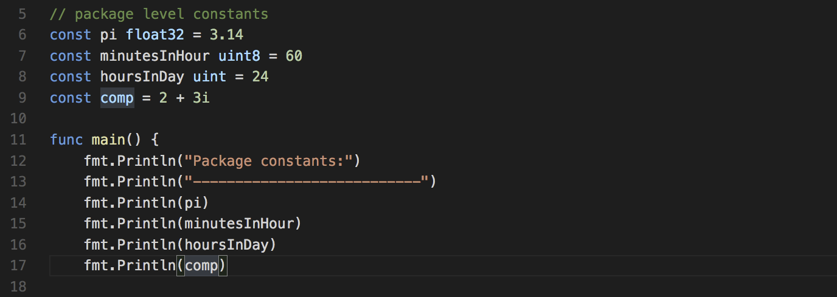
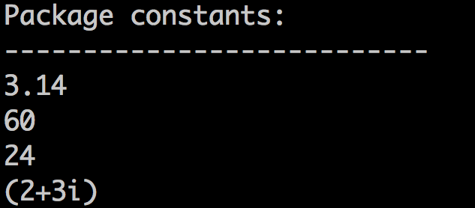
Example : constant/main.go

Slide 79
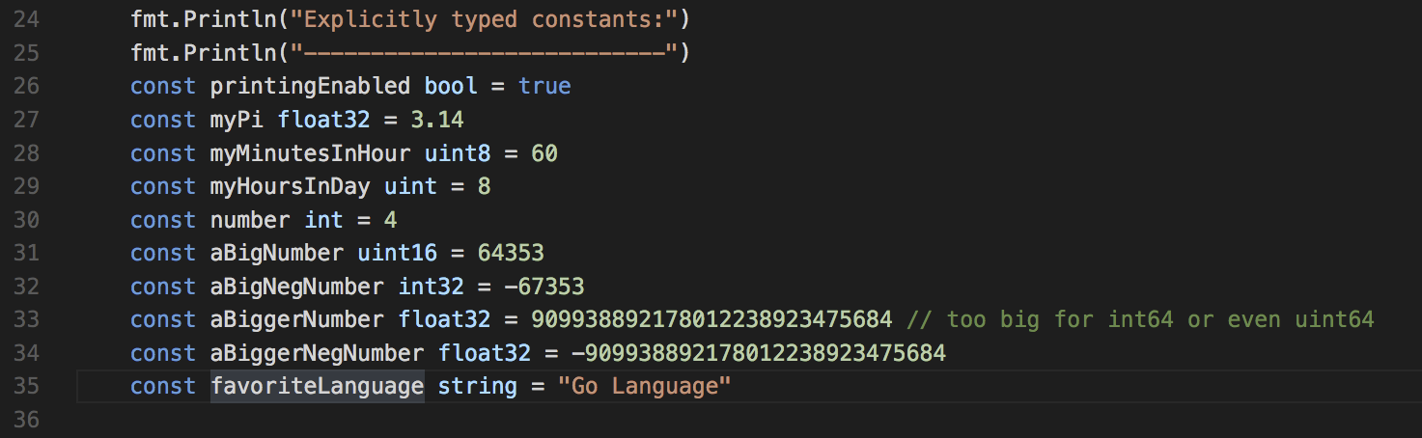
Explicit Typed Constants

Slide 80
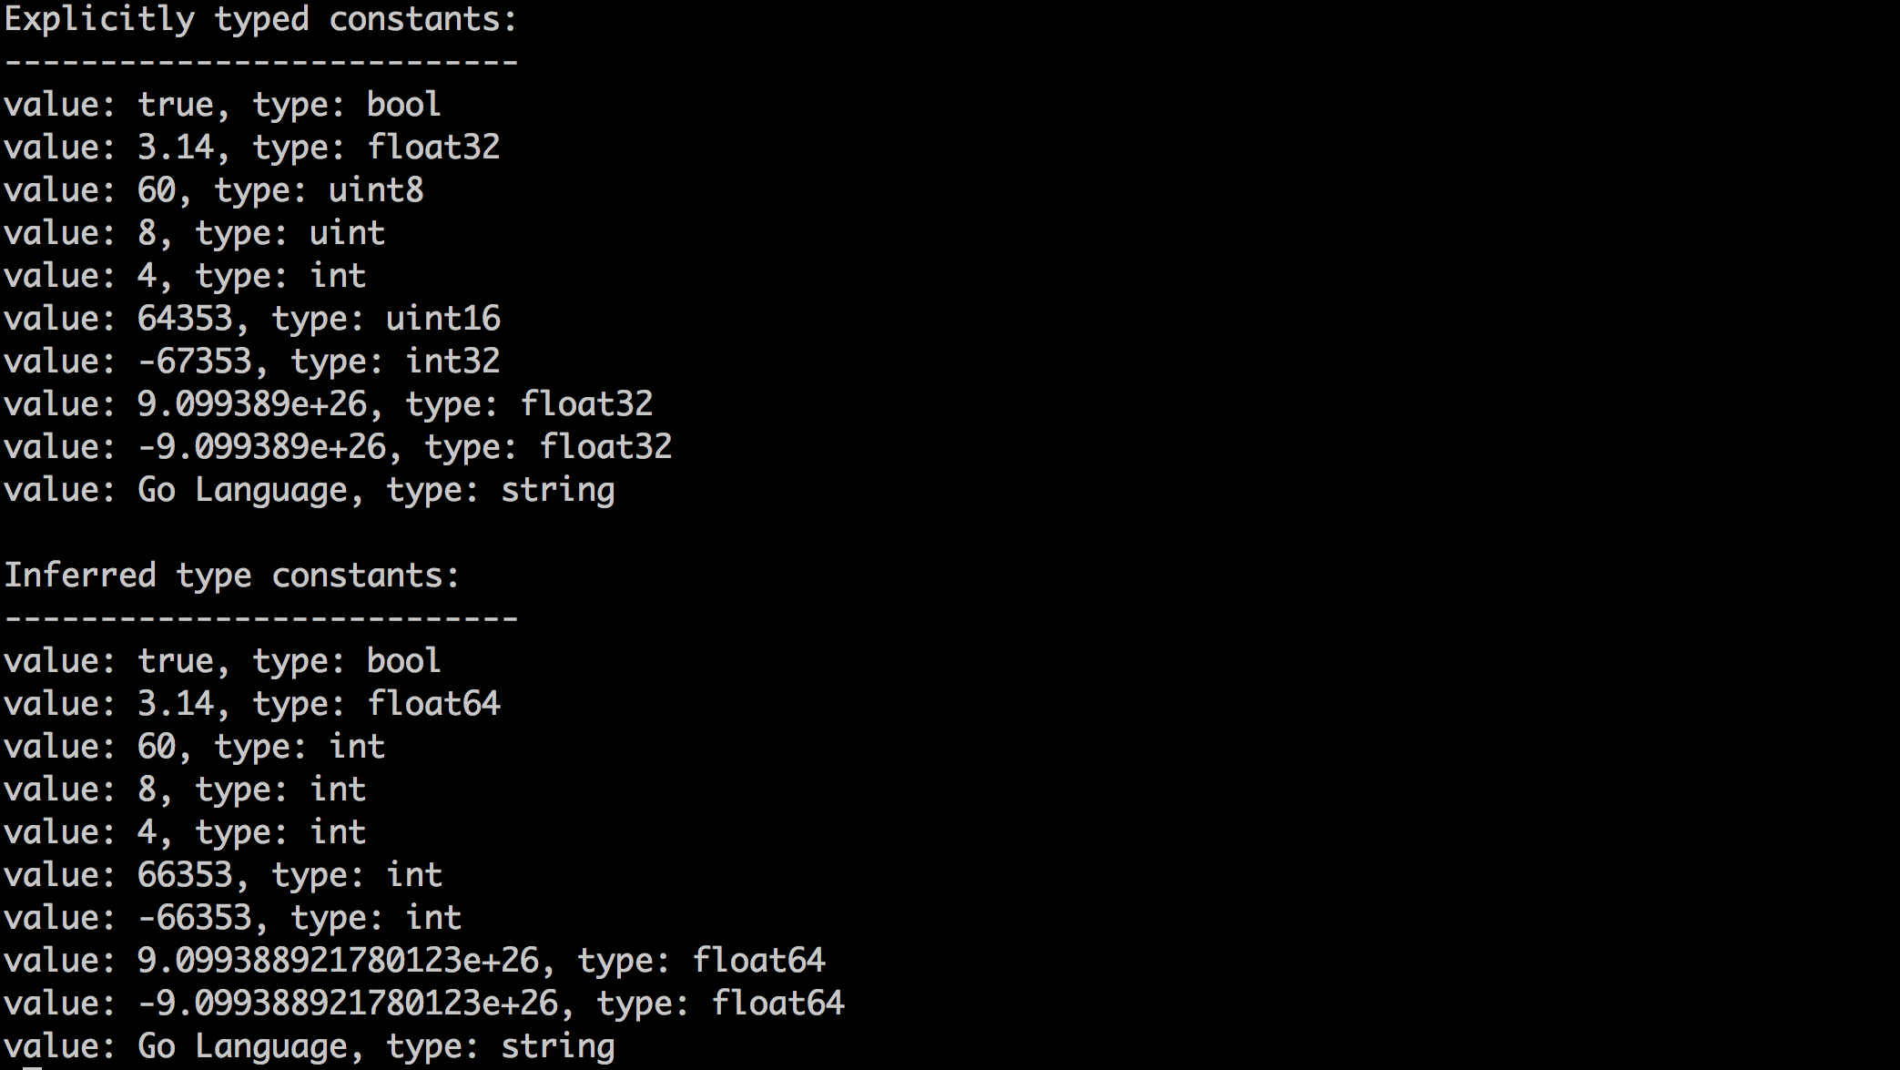
Explicit vs Inferred Type Constant

Slide 81
Definition: Variable
What is a ‘variable’?
Verrol’s definition:
A variable is a named abstraction to recall or reference a value
A variable can be used anywhere a value is required/expected.
We use variables to tag/associate data in memory
Property:
Variables can change their values over the life of the program
Examples:
itemCount
price
myName
isLoggingEnabled

Slide 82
Syntax: Variable
How do you define a ‘variable’?
Formal Syntax:
var name/identifier [type] = value
Examples:
var itemCount uint = 537
var price float32 = 235.87
var myNme string = “Verrol”
var isLoggingEnabled bool = false
Type Inferred Syntax:
var name/identifier = value
Examples:
var itemCount = 537
var price = 235.87
var myNme = “Verrol”
var isLoggingEnabled = false

Slide 83
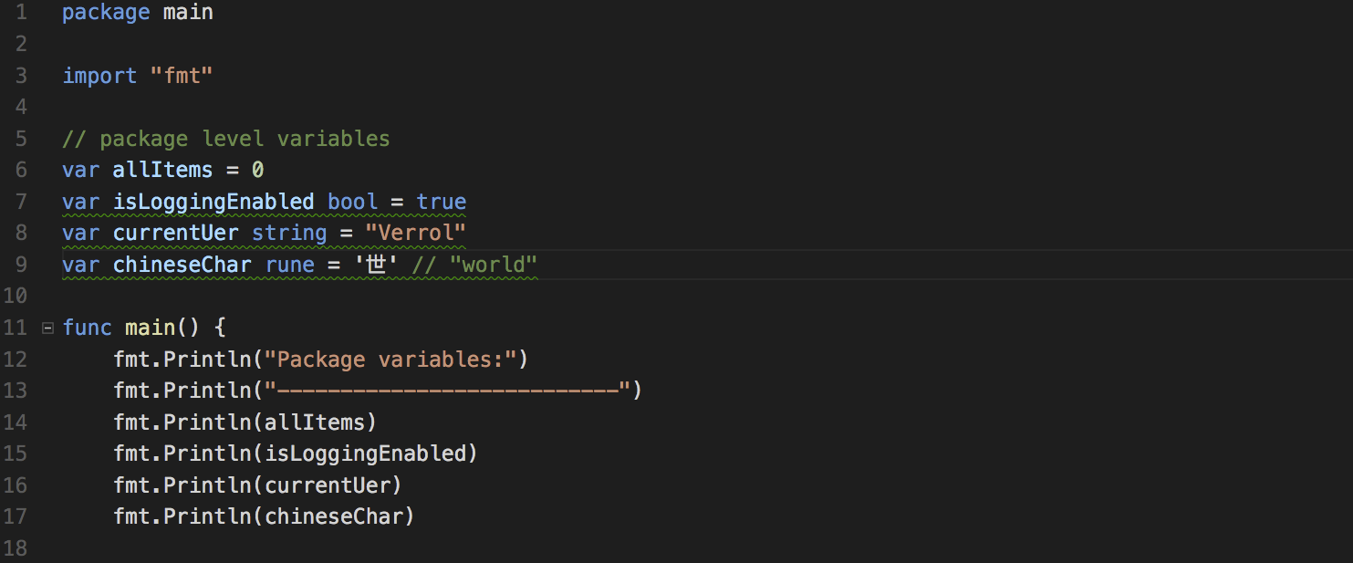
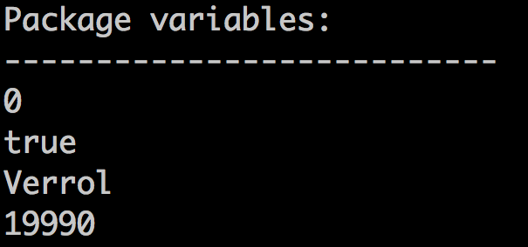
Example: variable/main.go

Slide 84
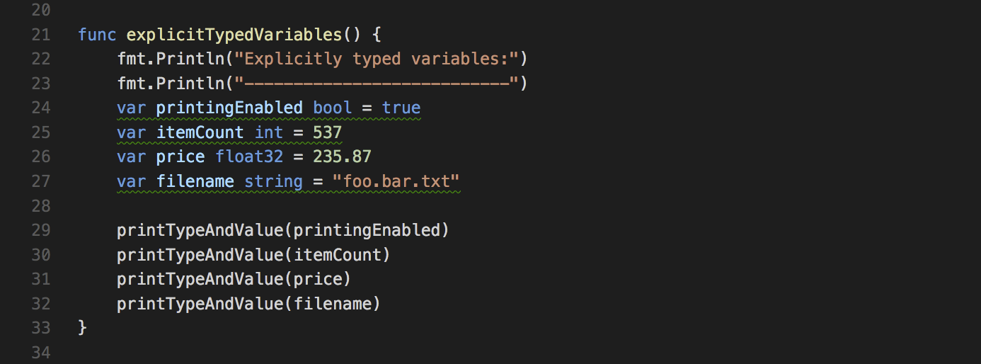
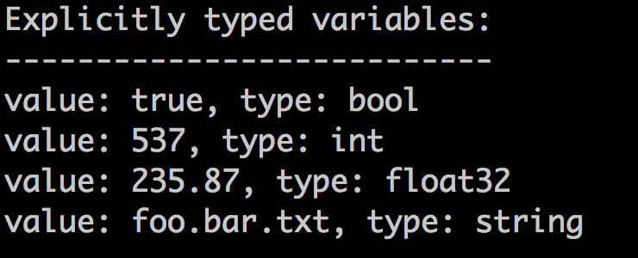
Explicitly Typed Variable

Slide 85
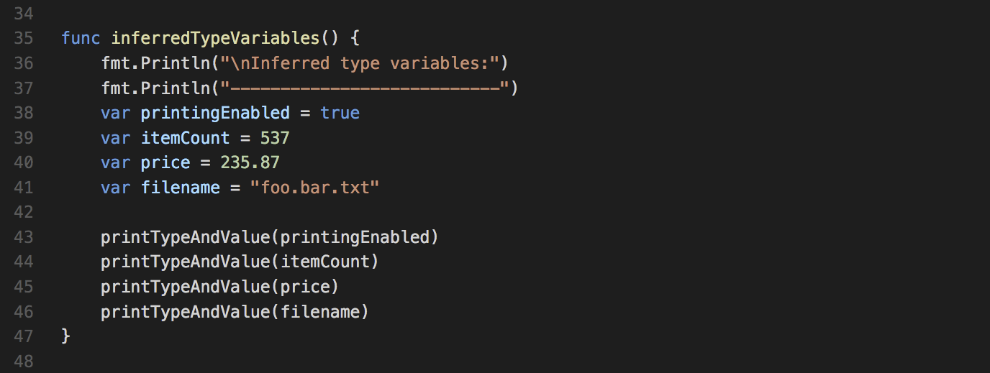
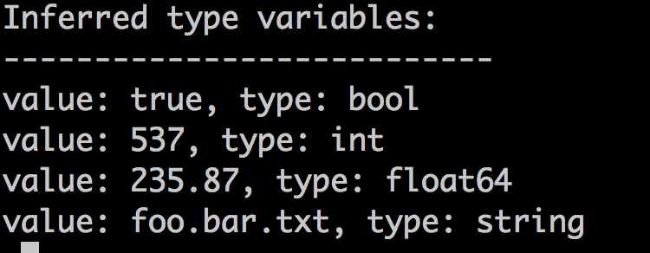
Inferred Type Variable

Slide 86
Constants and Variables in Memory
data
0
10
address
20
30
const/var | Address | Type
price | 0 | float64
flag | 8 | boolean
count | 10 | int32
message | 14 | string
name | 34 | string

Slide 87
Chapter 2 : The Basics
Section 6 – Pointers

Slide 88
Objectives
What is a ‘pointer’?
Understanding and using ‘pointers’

Slide 89
Revisiting Data Storage
We have a value 1737

Slide 90
Revisiting Data Storage
Our value 1737 is stored somewhere in memory
1737

Slide 91
Revisiting Data Storage
Our value’s location in memory is its address
1737
Address: 156

Slide 92
Revisiting Data Storage
We use a variable name to represent a value in memory
count: 1737
Address: 156

Slide 93
Revisiting Data Storage
Regardless of the value, both value and address are just numbers
count: 1737
011011001001
Address: 156
10011100

Slide 94
Revisiting Data Storage
Since an address in memory is just a number, we can store an address in yet another named value somewhere else in memory.
pCount: 156
count: 1737
Address: 198
Address: 156

Slide 95
Pointer or Indirection
We have just created a pointer. Since ‘pCount’ doesn’t contain the value of ‘count’, but rather where to find the value of ‘count’ in memory.
pCount: 156
count: 1737
Address: 198
Address: 156

Slide 96
Using Pointer
There are two parts to using a ‘pointer’:
Reference and Dereference
Reference: refers to the act of getting an address, the pointer.
We use the ‘address of’ operator, &, to get the address of a variable:
Eg: countAddress = &count
Dereference: means take this address/pointer, and return the value stored there.
We use the ‘dereference’ operator, *, to get the value of the indirection.
Eg: copyOfCount = *countAddress

Slide 97
‘Address Of’ Operator : &
Use the ‘address of’ operator to get the address of a variable.
count: 1737
&
156
Address: 156

Slide 98
‘Address Of’ Operator : &
Use the ‘address of’ operator to get the address of ANY variable*.
pCount: 156
&
198
Address: 198
*NOTE: You can’t take the address of a constant.

Slide 99
Dereference Operator: *
Use the ‘dereference’ operator to get the value of a pointer.
NOTE: A ‘pointer’ is a memory location.
pCount: 156
*
1737
Address: 198

Slide 100
Dereference Operator: *
Use the ‘deference’ operator to get the value of ANY pointer.
ppCount: 198
*
156
ppCount: 198
pCount: 156
count: 1737
Address: 742
Address: 198
Address: 156

Slide 101
Declaring Pointer Variables
How do you declare a ‘variable’ which holds a ‘pointer’?
Syntax:
var name/identifier [type] [= pointer value]
Where ‘type’ is:
<# indirections><type of value>
Examples:
var addressOfCount = &count
var buffer *byte
var pMessage = &message
var ptrLoggingEnabled = &isLoggingEnabled
NOTE: A pointer variable that is not given a value gets the value ‘nil’, which is like 0.

Slide 102
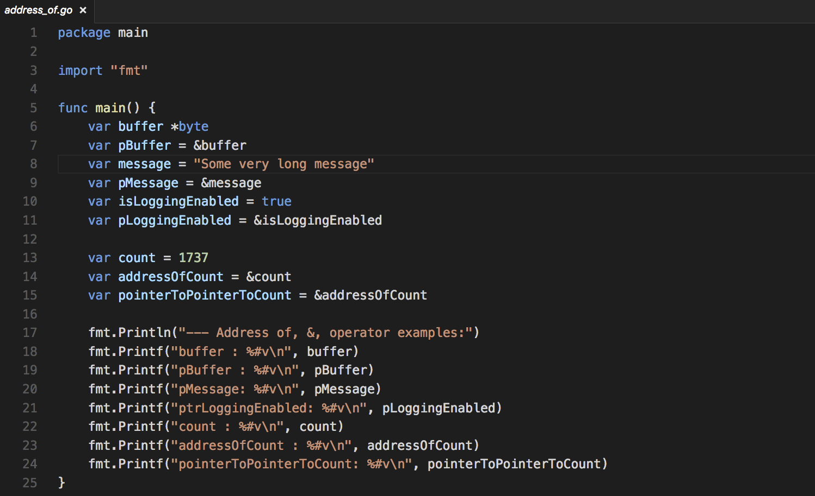
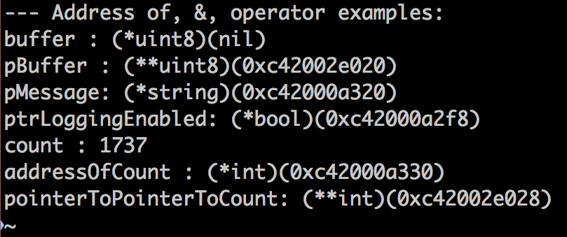
Example: Address Of

Slide 103
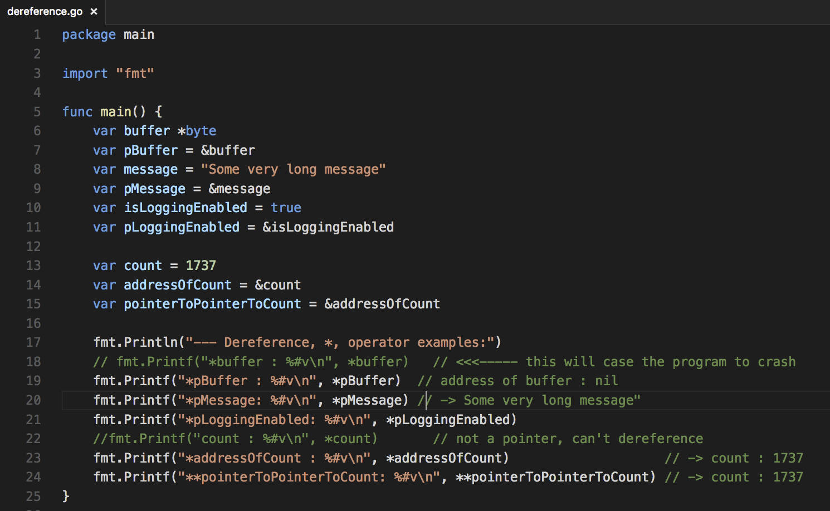
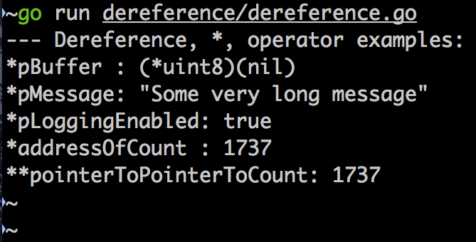
Example: Dereference

Slide 104
Closing Remarks
Pointers are cool
Not as scary as they may first seem
Provides indirection, which can be useful in manipulating large mounts of data

Slide 105
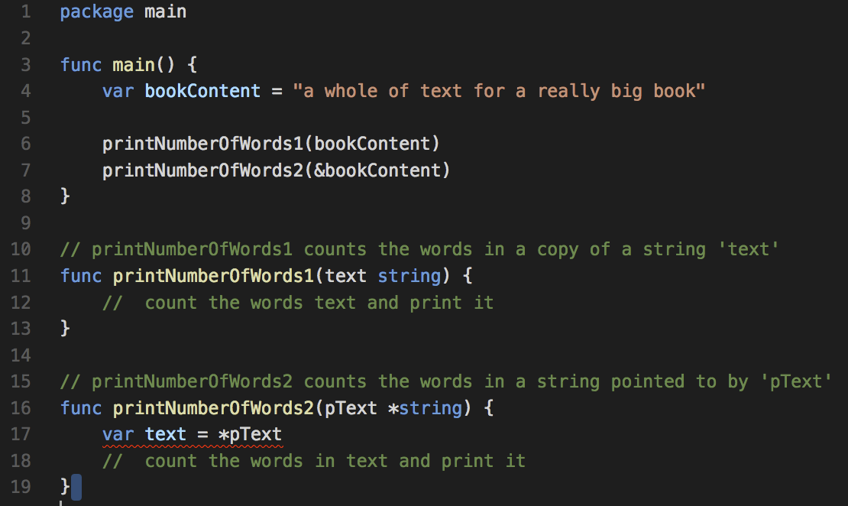
Illustration ONLY

Slide 106
Go Lang Programming
Ch.2 : The Basics
7 – The ‘if’ Statement

Slide 107
Topics
What is ‘Control Flow’?
The ‘if’ Statement
Examples of using the ‘if’ Statement

Slide 108
Our Programs So Far
Start
Statement 1
Statement 2
Statement 3
Statement …
Statement N
End

Slide 109
What “if”?
Instead of this
You want this
true
false

Slide 110
Skip
Start
Statement 1
Statement 2
Statement 3
Statement …
Statement N
End

Slide 111
Choosing One of Two Paths
Start
Statement 1
Statement 2
Statement 3
Statement …
Statement N
End

Slide 112
Choosing One Of Many Paths
Start
Statement 1
Statement A
Statement B
Statement Z
Statement …
Statement N
End

Slide 113
Choosing One Of Many Paths
Start
Statement 1
Statement A
Statement B
Statement Z
Statement …
Statement N
End

Slide 114
Conclusion
Control Flow gives the programmer the ability to write more sophisticated and elegant programs
The ‘if’ statement is one of the most often used control-flow statement
The ‘if’ statement allows for the execution of different branches in the program

Slide 115
Go Lang Programming
Ch.2 : The Basics
8 – The ‘switch’ Statement

Slide 116
Topics
The ‘switch’ Statement
Understanding Fall-through

Slide 117
Choosing One Of Many Paths
Start
Statement 1
Statement A
Statement …
Statement Z
Statement …
Statement N
End

Slide 118
Conclusion
A ‘switch’ statement can be used in place of a multi-condition ‘if’ statement
The ‘switch’ statement provides ‘fall through’, but it must be used with care

Slide 119
Go Lang Programming
Ch.2 : The Basics
9 – The ‘for’ Statement

Slide 120
Topics
The ‘for’ Loop Statement
The careful of the infinite loop
Skipping statements within a for loop with ‘continue’
Ending a for loop early with ‘break’

Slide 121
Repeat/Loop
Start
Statement 1
Statement …
Statement …
Statement N
End

Slide 122
Go Lang Programming
Ch.2 : The Basics
10 – Functions

Slide 123
Objectives
What is a ‘function’?
Defining and calling ‘functions’
Code and slides: https://github.com/xiliax/go-lang-programming

Slide 124
Definition: Functions
What is a ‘function’?
Verrol’s definition:
A ‘function’ ’ is a name given to a collection/set of statements
What are the benefits of functions?
Reuse
Organization
Abstraction
Effective Go: https://golang.org/doc/effective_go.html#functions

Slide 125
Named Function Syntax
func name([argument list]) [(return list)]{
body
}
Argument List
Optional comma separated list of variable names
Return list
Optional comma separated list of return variable(s) or type(s)
Body
Zero or more statements

Slide 126
Anonymous Function Syntax
var name = func([argument list]) ) [(return list)]{
body
}

Slide 127
Function Argument List
Some examples of function argument list:
No parameter
func foo()
A single parameter
func foo(a int)
One or more parameter of the same type
func foo(a, b, c float32)
One or more different parameters
func foo(a int, c string, z float32)
Optional variadic parameter
func foo(a int, c string, …z float32)

Slide 128
Function Return List
Some examples of function return list:
No return
func foo(…)
A single unnamed return
func foo(…) int
A single named return
func foo(…) a int
One or more parameter of the same type
func foo(…) (a, b, c float32)
One or more different parameters
func foo(…) (a int, c string, z float32)

Slide 129
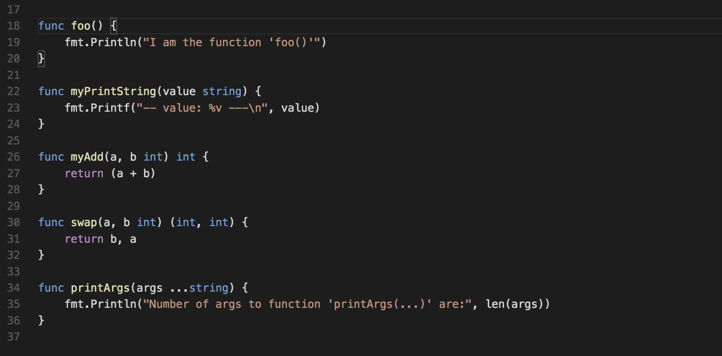
Example-00

Slide 130
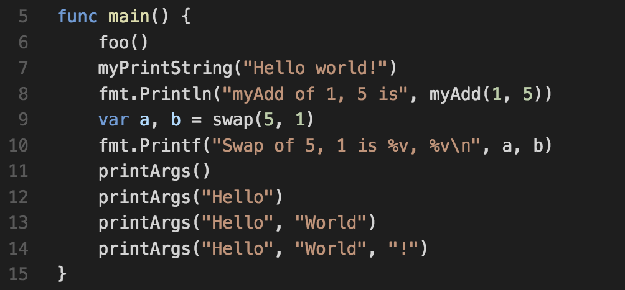
Example-00

Slide 131
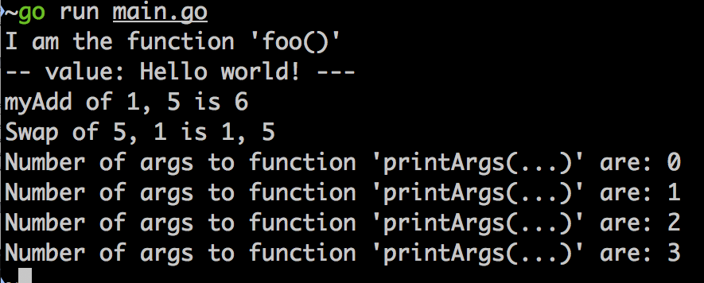
Example-00

Slide 132
Variables Inside of Functions
Functions can have variables definition
Variables defined in a function, is visible inside the function
Unlike C/C++, function can return the address of their variables

Slide 133
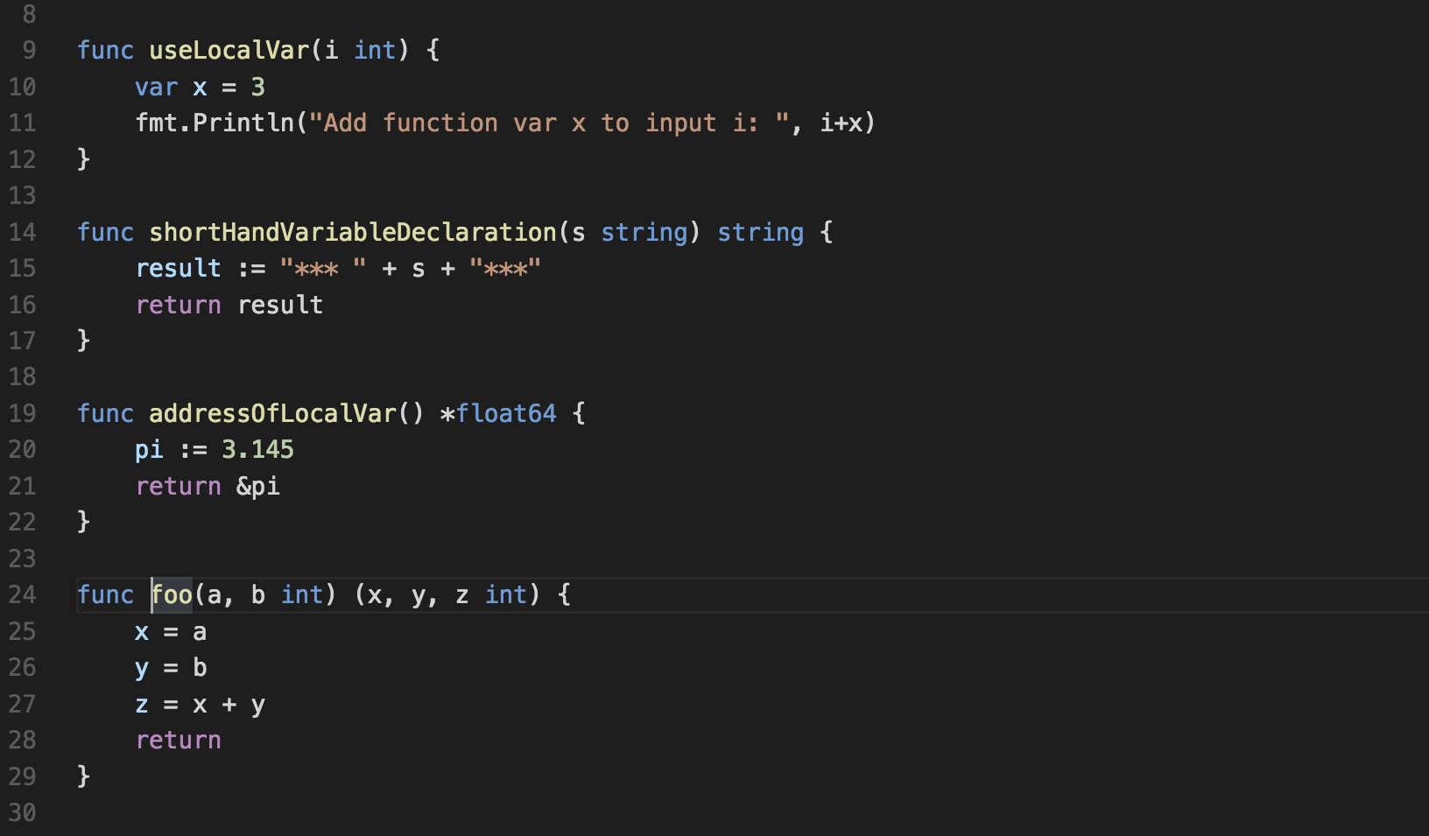
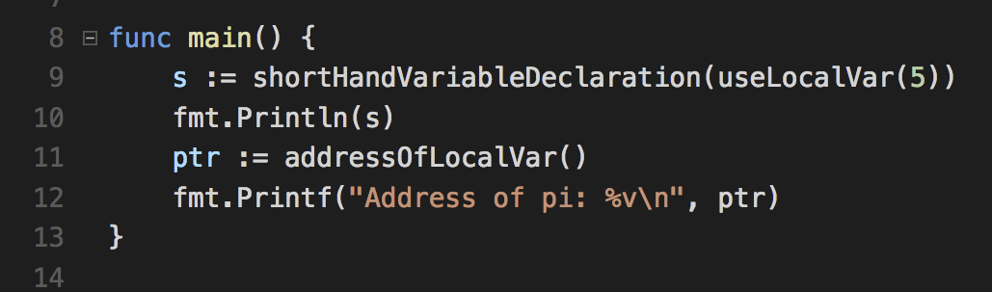
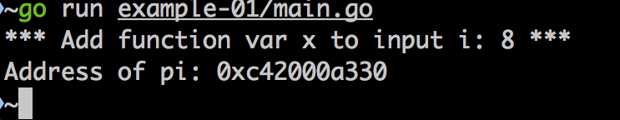
Example-01

Slide 134
Summary
In Go, a function is introduced with the ‘func’ keyword
Functions can optionally accept 0 or more parameters, inputs
Functions can optionally return 0 or more values
Functions create their own scope, which mean variables inside of functions are different from variables outside of the function.
Code and slides: https://github.com/xiliax/go-lang-programming

Slide 135
Go Lang Programming
Ch.2 : The Basics
11 – Packages

Slide 136
Objectives
What is a ‘package’?
Using ‘packages’
Defining ‘packages’
Code and slides: https://github.com/xiliax/go-lang-programming

Slide 137
Definition: Package
What is a ‘package’?
Go programs are constructed by linking together packages. A package in turn is constructed from one or more source files that together declare constants, types, variables and functions belonging to the package and which are accessible in all files of the same package. Those elements may be exported and used in another package.
Lang Specification: https://golang.org/ref/spec#Packages

Slide 138

Package Visualization
…
Package: foo
C
V
F
T
C = Constant
V = Variable
F = Function
T = Type

Slide 139
What are the benefits of Packages?
Reuse
Organization
Abstraction

Slide 140
Package Details
Visibility
Private members available to all members regardless of file
Public/Exported members are accessible to imported file
Types of imports:
Import Declaration | Local Name of Sin
import “lib/math” | math.Sin
import m “lib/math” | m.Sin
import . “lib/math” | Sin

Slide 141
Package Visibility
Package: foo
Private
Exported
C
V
F
T
C = Constant
V = Variable
F = Function
T = Type

Slide 142
Executable Visualized
…
Package: main
Package: fmt
Package: os
…
Package: recipe
Package: net/http
Package: strconv
Executable: recipe-manager

Slide 143
Demo
Contrive Example Requirements
Simple ‘awesome’ application
Simple ‘security’ package
Exposes: Login(), Logout(), IsAuthenticated()
Private: currentUser
Recipe Manager Application
‘recipe’ package
Uses ‘security’ package

Slide 144
Package Installation
$GOPATH
src
recipe-manager
awesome-app
pkg
fmt
recipe
recipe
bin
awesome
security-pkg
security
import “security”
$ cd security && go install

Slide 145
Go Lang Programming
Ch.2 : The Basics
12 – Chapter Review

Slide 146
Objectives
Chapter review in the form of an application
Uses some of the concepts from this chapter
Pointers
Functions
Flow control
Packages and application organization
NOTE: Contrive application
Code and slides: https://github.com/xiliax/go-lang-programming

Slide 147
Go Lang Programming
Ch.3 : Arrays
1 – Introduction to Arrays

Slide 148
Definition: Package
What is an ‘array’?
An array in Go lang is a built in datatype with the following features:
Stores several values of the same type
Provides compile-time bounds checking on integer literal index
Provides runtime-time bounds checking on integer variable index
Provides non-negative integer index
Uses 0-base indexing
Lang Specification: https://golang.org/ref/spec#Array_types

Slide 149
Summary
Declaring an array if very simple:
var name/identifier [type]
Eg: var testResults [10]int
Assigning values to an array’s element
arrayName[index] = value
Eg:
testResults[0] = 12
testResults[9] = 103
Bound checking prevents illegal or dangerous access:
arrayName[invalid-index] = value
Eg:
testResults[-1] = 12
Negative index
testResults[10] = 103
Index out of bounds, greater than the number of defined elements

Slide 150
Go Lang Programming
Ch.3 : Arrays
2 – Using Arrays

Slide 151
Objectives
Using Arrays
Calculating Array Length
Array Indexing
Arrays as Function Parameter and Return Types
Lang Specification: https://golang.org/ref/spec#Array_types

Slide 152
Summary
An arrays type is not very different from any other basic type
Calculate the length of an array at runtime using ‘len’
A range of array elements can be accessed using a ‘slice’
arrayName[start-index:end-index+1]
Eg:
testResults[0:5]
Index 0, 1, 2, 3, and 4
testResults[4:9]
Index 4, 5, 6, 7, and 8

Slide 153
Go Lang Programming
Ch.3 : Arrays
3 – Iteration with ‘for’ and range()

Slide 154
Objectives
Using a ‘for’ Loop to Traverse an Array’s Elements
How the range() Simplifies the ‘for’ Loop
Lang Specification: https://golang.org/ref/spec#Slice_types
Go Slices: Usage and Internals: https://blog.golang.org/go-slices-usage-and-internals

Slide 155
Go Lang Programming
Ch.3 : Arrays
4 – Arrays and Functions

Slide 156
Objectives
Using Arrays
Passing Arrays as Function Parameter
Arrays as Function Return Types
Tips on Using Arrays with Function
Using Array Pointer to pass large arrays to functions
Return a Array Pointer to large arrays in function
For simplicity, use a slice created at runtime*
* We will cover ‘slices’ in the next section
Lang Specification: https://golang.org/ref/spec#Array_types

Slide 157
Summary
An Array in Go Lang is a value
Therefore, it gets copied when assigned

Slide 158
Go Lang Programming
Ch.4 : Slices
1 – What are Slices

Slide 159
Objectives
How to create Slices
What is a Slice?
Lang Specification: https://golang.org/ref/spec#Slice_types
Go Slices: Usage and Internals: https://blog.golang.org/go-slices-usage-and-internals

Slide 160
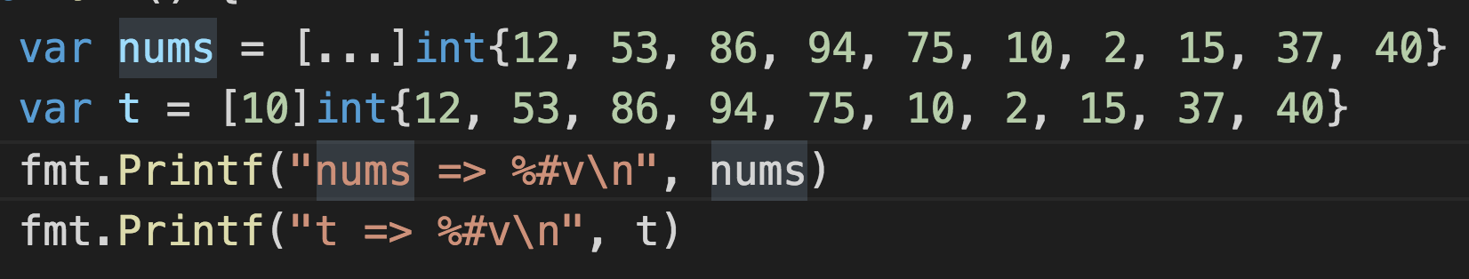

Array Illustrated
nums array
12
53
86
94
75
10
2
15
37
40
0
1
2
3
4
5
6
7
8
9
Array length: 10 or len(nums)

Slide 161
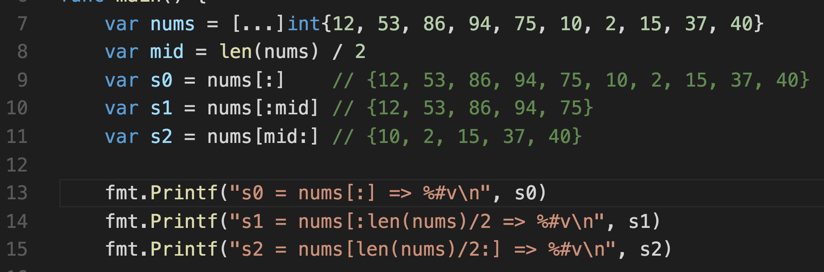
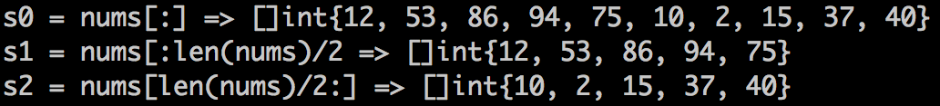
Creating Slices
nums array
12
53
86
94
75
10
2
15
37
40
0
1
2
3
4
5
6
7
8
9

Slide 162
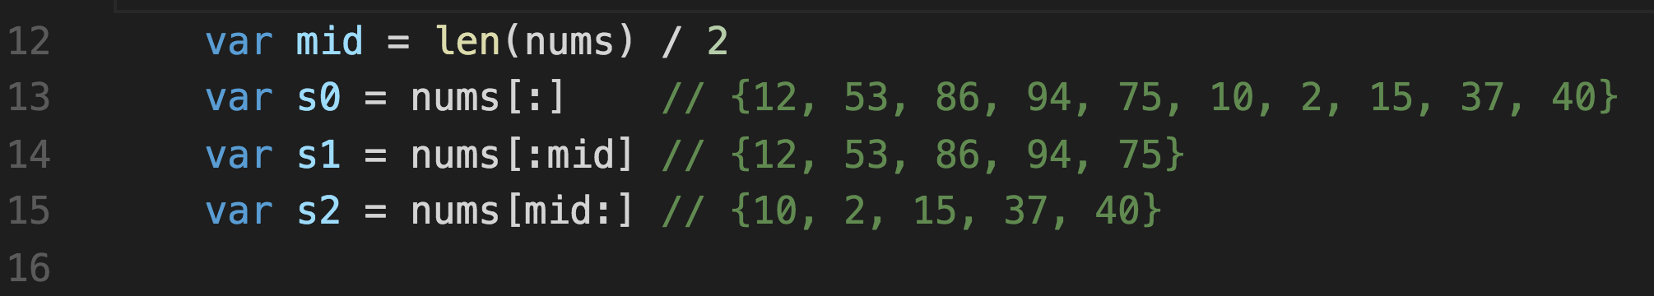
Slice Illustrated
s0
Array: nums
Offset: 0
Length: 10
nums =>
12
53
86
94
75
10
2
15
37
40
0
1
2
3
4
5
6
7
8
9
s1
s2
Array: nums
Offset: 0
Length: 5
Array: nums
Offset: 5
Length: 5

Slide 163
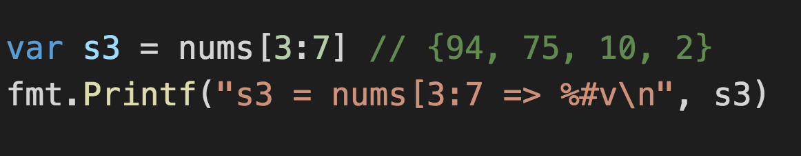
Slice Illustrated
s3
Array: nums
Offset: 3
Length: 4
nums =>
12
53
86
94
75
10
2
15
37
40
0
1
2
3
4
5
6
7
8
9

Slide 164
Summary
A Slice is an efficient abstraction built on an Array
Slices gives you all the benefits of an Array, without none of the drawbacks

Slide 165
Go Lang Programming
Ch.4 : Slices
2 – Iteration with ‘for’ and range()

Slide 166
Objectives
Using a ‘for’ Loop to Traverse the Slice’s Elements
How the range() Simplifies the ‘for’ Loop
Lang Specification: https://golang.org/ref/spec#Slice_types
Go Slices: Usage and Internals: https://blog.golang.org/go-slices-usage-and-internals

Slide 167
Go Lang Programming
Ch.4 : Slices
3 – A Slice’s Capacity

Slide 168
Objectives
What is the ‘capacity’ of a Slice?
Using the ‘cap’ built-in function
Re-slicing a Slice
Lang Specification: https://golang.org/ref/spec#Slice_types
Go Slices: Usage and Internals: https://blog.golang.org/go-slices-usage-and-internals

Slide 169
Slice Illustrated
s3
Array: nums
Offset: 3
Length: 4
nums =>
12
53
86
94
75
10
2
15
37
40
0
1
2
3
4
5
6
7
8
9
0
1
2
3
capacity

Slide 170
Slice Illustrated
s3
Array: nums
Offset: 3
Length: 4
Capacity: 7
nums =>
12
53
86
94
75
10
2
15
37
40
0
1
2
3
4
5
6
7
8
9
capacity

Slide 171
Slice Illustrated
s0
Array: nums
Offset: 0
Length: 10
Capacity: 10
nums =>
12
53
86
94
75
10
2
15
37
40
0
1
2
3
4
5
6
7
8
9
s1
s2
Array: nums
Offset: 0
Length: 5
Capacity: 10
Array: nums
Offset: 5
Length: 5
Capacity: 5

Slide 172
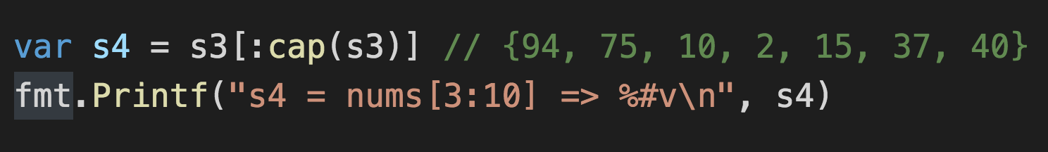
Slice Illustrated
s3
Array: nums
Offset: 3
Length: 4
Capacity: 7
nums =>
12
53
86
94
75
10
2
15
37
40
0
1
2
3
4
5
6
7
8
9
s4
Array: nums
Offset: 3
Length: 7
Capacity: 7

Slide 173
Summary
A Slice’s capacity tell you how much more of the underlying Array is reserved.

Slide 174
Go Lang Programming
Ch.4 : Slices
4 – Creating Slices with make()

Slide 175
Objectives
Creating Slices at runtime
Using the ‘make’ built-in function
Lang Specification: https://golang.org/ref/spec#Slice_types
Go Slices: Usage and Internals: https://blog.golang.org/go-slices-usage-and-internals

Slide 176
Go Lang Programming
Ch.4 : Slices
5 – Growing Slices with append()

Slide 177
Objectives
Understanding and using ‘append()’ built-in function
Using the ‘append’ built-in function to grow Slices
Lang Specification: https://golang.org/ref/spec#Slice_types
Go Slices: Usage and Internals: https://blog.golang.org/go-slices-usage-and-internals

Slide 178

Slice Created with make()
s0
Array: <anonymous>
Offset: 0
Length: 2
Capacity: 3
0
0
0
0
1
2
capacity

Slide 179
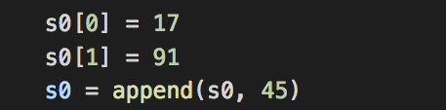
Appending Element(s) to Slice’s Capacity
s0
s0
Array: <anonymous>
Offset: 0
Length: 2
Capacity: 3
Array: <anonymous>
Offset: 0
Length: 3
Capacity: 3
17
91
0
17
91
45
0
1
2
0
1
2
capacity
capacity

Slide 180
Appending Element(s) beyond Slice’s Capacity
s0
t
s0 = t
Array: <anonymous>
Offset: 0
Length: 2
Capacity: 3
Array: <anonymous>
Offset: 0
Length: 2 + 3
Capacity: 2+3
Array: <anonymous>
Offset: 0
Length: 5
Capacity: 5
17
91
17
91
51
82
42
0
1
2
0
1
2
3
4
0
1
2
3
4
capacity
capacity
capacity

Slide 181
Responsibility for the ‘append()’ function
Determine how many elements are being added to slice
Does underlying array has place for new elements?
In other words, is the ‘cap() – len()’ greater than or equal to number of new elements
If the array is not big enough, allocate a new slice with ‘sufficient length and capacity’
copy existing slice to new slice
Copy new elements to new slice
Return ‘updated’ slice

Slide 182
Go Lang Programming
Ch.4 : Slices
6 – Slice Spread Operator (…)

Slide 183
Objectives
Understanding how to use the ‘spread operator’, …
Call variadic functions using the elements of a Slice
Lang Specification: https://golang.org/ref/spec#Slice_types
Go Slices: Usage and Internals: https://blog.golang.org/go-slices-usage-and-internals

Slide 184
Go Lang Programming
Ch.4 : Slices
7 – Copying Slices with copy()

Slide 185
Objectives
Using the built-in copy() function for copying Slices
Advantages of built-in copy() function
Lang Specification: https://golang.org/ref/spec#Slice_types
Go Slices: Usage and Internals: https://blog.golang.org/go-slices-usage-and-internals

Slide 186
Things to Consider When Copying Collections
The size of the source and destination collections
Source has more objects/elements than destination
Overlapping collections
When source and destination are the same

Slide 187
Overlapping Slices Copy Illustration
d1
s1
Array: <anonymous>
Offset: 1
Length: 3
Array: <anonymous>
Offset: 0
Length: 4
7
91
3
59
72
7
91
3
59
72
0
1
2
0
1
2
3
7
7
91
3
72
0
1
2

Slide 188
Overlapping Slices Copy Illustration
d1
s1
Array: <anonymous>
Offset: 1
Length: 3
Array: <anonymous>
Offset: 0
Length: 4
7
91
3
59
72
7
91
3
59
72
0
1
2
0
1
2
3
7
91
3
3
72
0
1
2
7
91
91
3
72
0
1
2
7
7
91
3
72
0
1
2

Slide 189
Go Lang Programming
Ch.4 : Slices
8 – Review

Slide 190
Objectives
Chapter Review
Display numbers visually with a chart
Simple histogram chart
Lang Specification: https://golang.org/ref/spec#Slice_types
Go Slices: Usage and Internals: https://blog.golang.org/go-slices-usage-and-internals

Slide 191
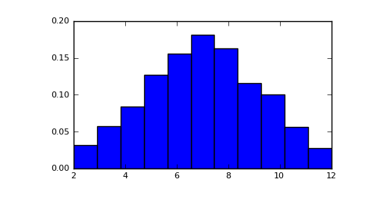
Histogram

Slide 192
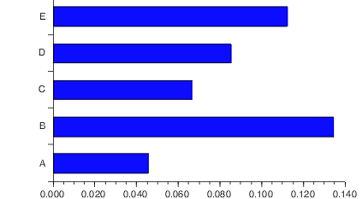
Histogram (horizontal)

Slide 193
Go Lang Programming
Ch.5 : Maps
1– Introduction to Maps

Slide 194
Objectives
What is a ‘map’ in Go Lang?
Formal definition
Declaring and using a ‘map’
Lang Specification: https://golang.org/ref/spec#Map_types
Go Maps in Action: https://blog.golang.org/go-maps-in-action

Slide 195
What is a Map?
Formal definition:
A map is an unordered group of elements of one type, called the element type, indexed by a set of unique keys of another type, called the key type.*

Slide 196
Map at a Glance
Intent
Construct | m := map[key]value{}
Insert | m[k] = v
Lookup | v = m[k]
Delete | delete(m, k)
Iterate | for k, v := range m
Size | len m
* Key-type must have == operation (no map, slice, or func)

Slide 197
Go Lang Programming
Ch.5 : Maps
2– Creating and Using Maps

Slide 198
Objectives
Creating Maps at runtime
Using the ‘make’ built-in function
Inserting elements into a Map
Retrieving elements from a Map
Deleting elements in a Map
Using the ‘delete’ build-in function
Counting the number of elements in a Map
Using the ‘len’ built-in function
Lang Specification: https://golang.org/ref/spec#Map_types
Go Maps in Action: https://blog.golang.org/go-maps-in-action

Slide 199
Go Lang Programming
Ch.5 : Maps
3– Iteration using ‘for’ and range()

Slide 200
Objectives
Using a ‘for’ Loop and ‘range’ to Traverse a Map’s Elements
How the range() Simplifies the ‘for’ Loop
Lang Specification: https://golang.org/ref/spec#Map_types
Go Maps in Action: https://blog.golang.org/go-maps-in-action

Slide 201
Go Lang Programming
Ch.5 : Maps
4 – Review

Slide 202
Objectives
Chapter Review
Display numbers visually with a chart
Simple histogram chart
Lang Specification: https://golang.org/ref/spec#Map_types
Go Maps in Action: https://blog.golang.org/go-maps-in-action

Slide 203
Histogram
20
15
10
5
0

Slide 204
Go Lang Programming
Ch.6 : Structs
1 – Introduction to Structs

Slide 205
Objectives
What is a Struct?
Arrays/Slices vs Maps vs Structs
Simple examples of using a Struct
Lang Specification: https://golang.org/ref/spec#Struct_types

Slide 206
What is a Struct?
A struct is a sequence of named elements, called fields, each of which has a name and a type. Field names may be specified explicitly (IdentifierList) or implicitly (AnonymousField). Within a struct, non-blank field names must be unique
Lang Specification: https://golang.org/ref/spec#Struct_types

Slide 207
Arrays/Slices vs Maps vs Structs
Array
12
53
86
94
75
10
2
15
37
40
0
1
2
3
4
5
6
7
8
9
Flexible element type
All elements are of the same type
Fixed boundaries
Integer indexing

Slide 208
Arrays/Slices vs Maps vs Structs
Map
“Near X-mas”
“After Summer”
“Summer Starts”
“November”
“September”
“July”
Flexible value type
All elements are of the same type
Flexible index types

Slide 209
Arrays/Slices vs Maps vs Structs
Struct
string
int
boolean
“Mary”
25
true
name
age
exempt
Composite of multiple types
Problem domain representation

Slide 210
Go Lang Programming
Ch.6 : Structs
2 – Nested and Anonymous Structs

Slide 211
Objectives
What is a Nested Struct?
Anonymous Struct
Accessing fields in an anonymous Struct
Dealing with ambiguity
Lang Specification: https://golang.org/ref/spec#Struct_types

Slide 212
Go Lang Programming
Ch.6 : Structs
3 – Review

Slide 213
Objectives
Review
How did we get here?
Lang Specification: https://golang.org/ref/spec#Struct_types

Slide 214
Everything is a Number
Everything typed into a computer is a character
Every character is represented by a number
A number is build up bit by bit, quite literally

Slide 215
What is a ‘bit’?
Bit
A bit, is like a switch, it is either on or off
Each bit represents a binary value of 0 or 1
1
0
0

Slide 216
Counting with ‘bits’
Just as 1 bit can designate 2 distinct states or values, using multiple bits can designate even higher numbers of states/values.
A pair of light bulbs, can have 4 distinct states. Hence, 2 bits can designate 4 distinct states/values.

Slide 217
Memory (simplified)
A mechanism or device for storing bytes
Memory capacity is measured in number of bytes
bytes
bits

Slide 218
Objectives
Understanding Data Types
Numbers
Byte
Rune
Integer
Float
Complex
Booleans
Strings
Data Type Storage (simplified)

Slide 219
Categorizing Values
Column 1
5
19
Verrol
true
false
3.14159
13.87
9/11/2001
Column 2
5e19
0.085
solid
orange
A
B
J
5 + 7i
5, 19, 5e19
3.14159, 13.87, 0.085
true, false
Verrol, solid, orange
A, B, j
9/11/2001
5 + 7i

Slide 220
Arrays/Slices vs Maps vs Structs
Array
12
53
86
94
75
10
2
15
37
40
0
1
2
3
4
5
6
7
8
9
Flexible element type
All elements are of the same type
Fixed boundaries
Integer indexing

Slide 221
Arrays/Slices vs Maps vs Structs
Map
“Near X-mas”
“After Summer”
“Summer Starts”
“November”
“September”
“July”
Flexible value type
All elements are of the same type
Flexible index types

Slide 222
Arrays/Slices vs Maps vs Structs
Struct
string
int
boolean
“Mary”
25
true
name
age
exempt
Composite of multiple types
Problem domain representation

Slide 223
Go Lang Programming
Ch.7 : Channels
1 – Introduction

Slide 224
Objectives
What is a Channel?
Using a simple buffered channel
Lang Specification: https://golang.org/ref/spec#Channel_types

Slide 225
What is a Channel?
A channel provides a mechanism for concurrently executing functions to communicate by sending and receiving values of a specified element type. The value of an uninitialized channel is nil.

Slide 226
Channel Communicating
channel
Goroutine 2
Goroutine 1
receive
send
Un-buffered Channel
Goroutine 2
Goroutine 1

Slide 227
Block on Send
Buffered Channel
Goroutine 2
Goroutine 1
…
…
Un-buffered Channel
Goroutine 2
Goroutine 1

Slide 228
Block on Receive
Buffered Channel
Goroutine 2
Goroutine 1
Un-buffered Channel
Goroutine 2
Goroutine 1

Slide 229
Types of Channels
Declaration | Notes
chan T | Allows sending and receiving

Slide 230
Go Lang Programming
Ch.7 : Channels
2 – Send-only Channels

Slide 231
Objectives
Declaring Send-only Channels
Playing with Send-only channels
Lang Specification: https://golang.org/ref/spec#Channel_types

Slide 232
Types of Channels
Declaration | Notes
chan T | Allows sending and receiving
chan<- T | Allows only sending of values of type T

Slide 233
Go Lang Programming
Ch.7 : Channels
3 – Receive-only Channels

Slide 234
Objectives
Receive-only Channels
Playing with Receive-only channels
Lang Specification: https://golang.org/ref/spec#Channel_types

Slide 235
Types of Channels
Declaration | Notes
chan T | Allows sending and receiving
chan<- T | Allows only sending of values of type T
<-chan T | Allows only receiving values of type T

Slide 236
Go Lang Programming
Ch.7 : Channels
4 – Function Returning Channels

Slide 237
Objectives
Functions That Returns a Channel
Producer function creates and return channel
Lang Specification: https://golang.org/ref/spec#Channel_types

Slide 238
Associativity of <-
# | Channel of Channels | Meaning
1 | chan<- chan int | same as chan<- (chan int)
2 | chan<- <-chan int | same as chan<- (<-chan int)
3 | <-chan <-chan int | same as <-chan (<-chan int)
4 | chan (<-chan int)
<- associates to the leftmost ‘chan’

Slide 239
Go Lang Programming
Ch.7 : Channels
5 – More Channel Stuff

Slide 240
Objectives
Use channel to send a string
Use Golang standard ‘time’ package
Lang Specification: https://golang.org/ref/spec#Channel_types

Slide 241
Go Lang Programming
Ch.7 : Channels
6 – Channel Selection

Slide 242
Objectives
Using the ‘select’ keyword to pick a channel
How to choose a channel?
Lang Specification: https://golang.org/ref/spec#Channel_types

Slide 243
Using a Single Channel

Slide 244
Selection

Slide 245
Selection

Slide 246
Selection
?
or
‘select’ uniformly picks one of the channels that is ready

Slide 247
Selection
?
or
‘select’ uniformly picks one of the channels that is ready

Slide 248
Go Lang Programming
Ch.7 : Channels
7 – More Channel Selection

Slide 249
Objectives
Using the ‘select’ keyword to pick a channel
One way to implement ‘timeout’
Lang Specification: https://golang.org/ref/spec#Channel_types

Slide 250
Go Lang Programming
Ch.7 : Channels
8 – Review

Slide 251
Objectives
Review and wrap up
Testing for a closed channel
Using ‘default’ case with ‘select’
Lang Specification: https://golang.org/ref/spec#Channel_types

Slide 252
Go Lang Programming
Ch.8 : Goroutines
1 – Introduction:
Walking and Chewing Gum

Slide 253
Objectives
Using the ‘select’ keyword to pick a channel
How to choose which channel?
Lang Specification: https://golang.org/ref/spec#Go_statements

Slide 254
References
A Tour of Go : Goroutine | https://tour.golang.org/concurrency/1
Concurrency | https://www.golang-book.com/books/intro/10
Rob Pike - 'Concurrency Is Not Parallelism' | https://www.youtube.com/watch?v=cN_DpYBzKso
Google I/O 2013 - Advanced Go Concurrency Patterns | https://www.youtube.com/watch?v=QDDwwePbDtw

